Slide 1
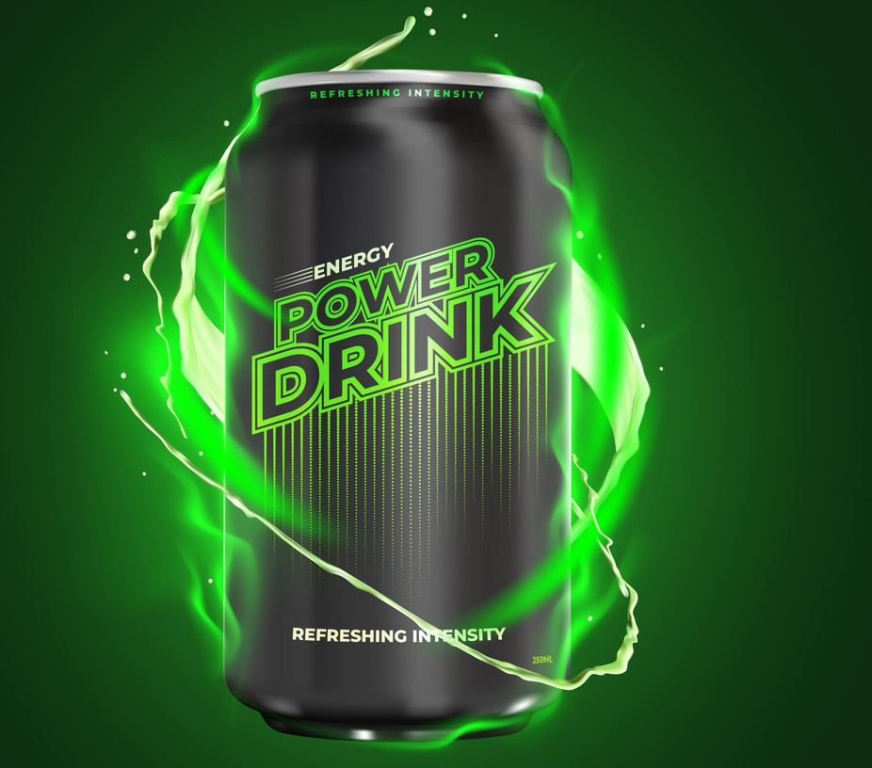
CodeX's Dynamic Marketing Strategy ffor India
By Pranav Khot

Slide 2




Agenda
Introduction
Task Insights&Recommendations Suggestions

Slide 3

INTRODUCTION
CodeX, a German beverage company, recently launched its energy drink in 10 cities in India. The Marketing team aims to increase brand awareness, market share, and product development. They conducted a survey with 10,000 respondents in these cities.

Slide 4

Task
Conduct an analysis on survey responses and provide actionable recommendations for CodeX's Chief Marketing Officer.

Slide 5



MAIN GOALS
Increase Brand Awareness
Identify Target Consumers
Increase Market Share
Product Devolpment

Slide 6
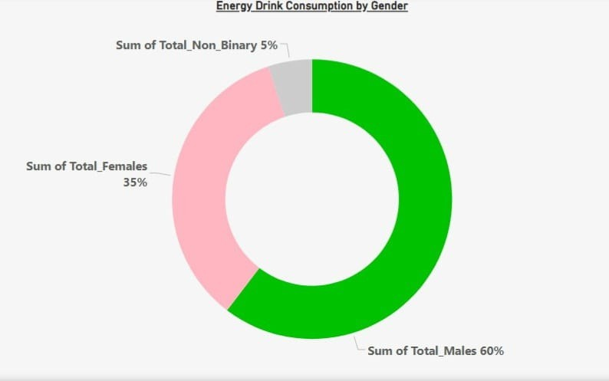


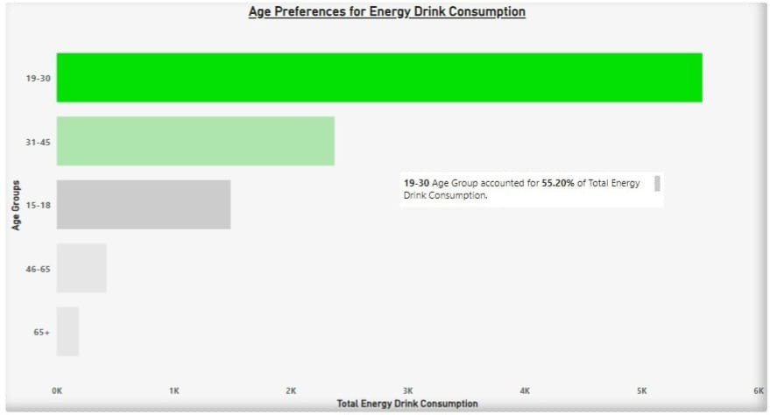

60% Cosumers are Male
19-30 Age Group accounted for around 56% of total energy drink consuption

Slide 7
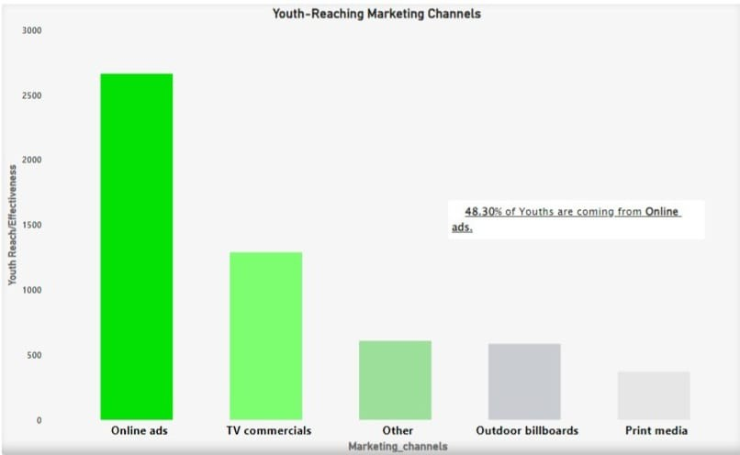

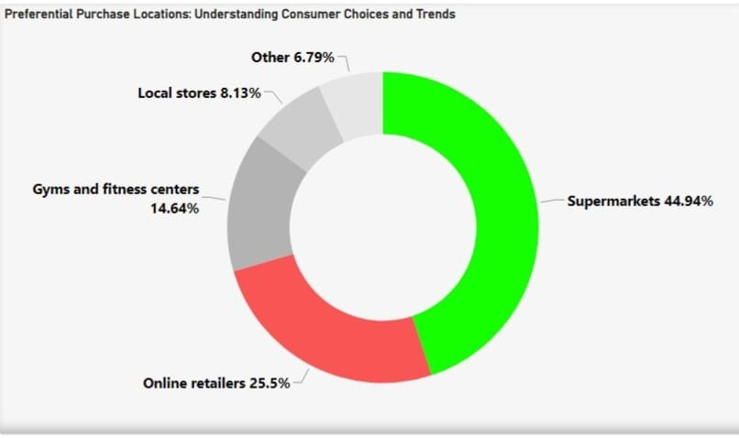

Around 49% of Youth are coming from online ads.
45% of consumers prefer purchasing drink from Supermarkets and 25% from Online.

Slide 8
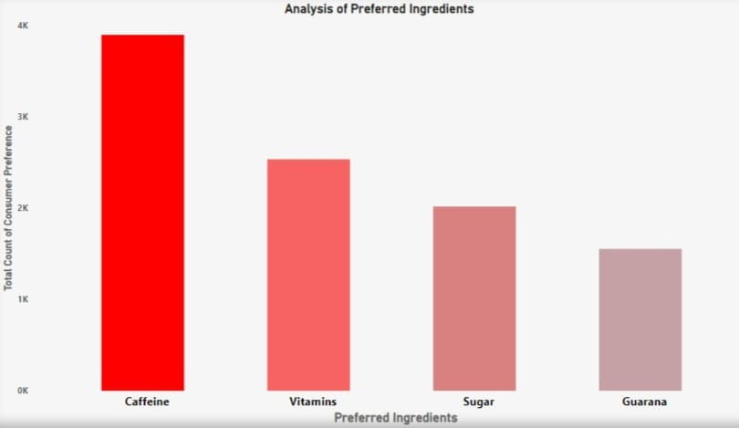




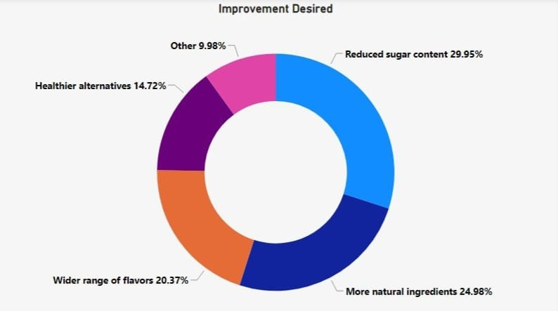

Caffine &Vitamins are the most desired ingredients
Consumers need more natural ingredients in the drink

Slide 9
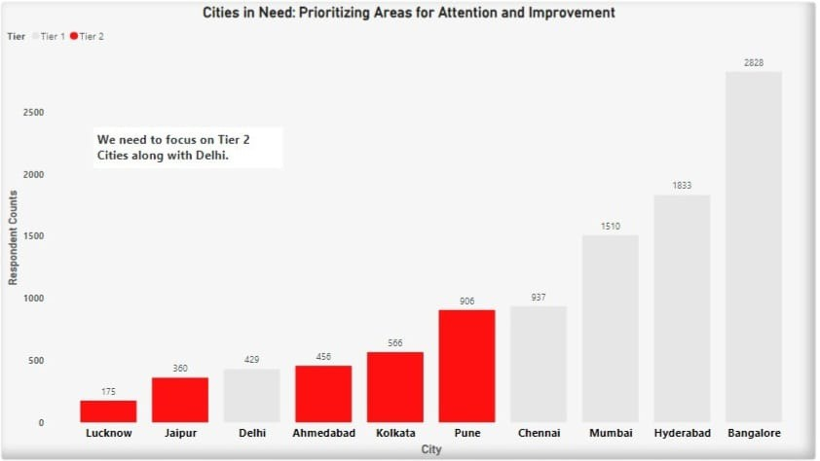
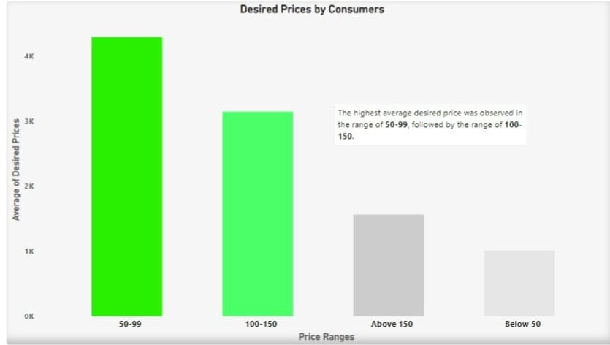
There are oppurtunities in Tier2 Cities for market expansion.
The most preferred price range for consumers were 50-99 and 100-150.

Slide 10
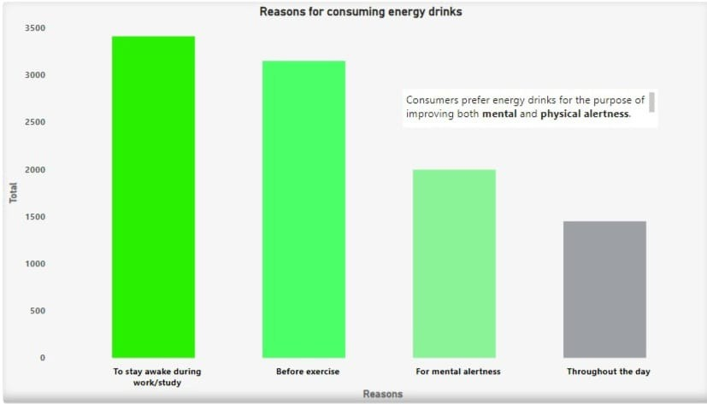
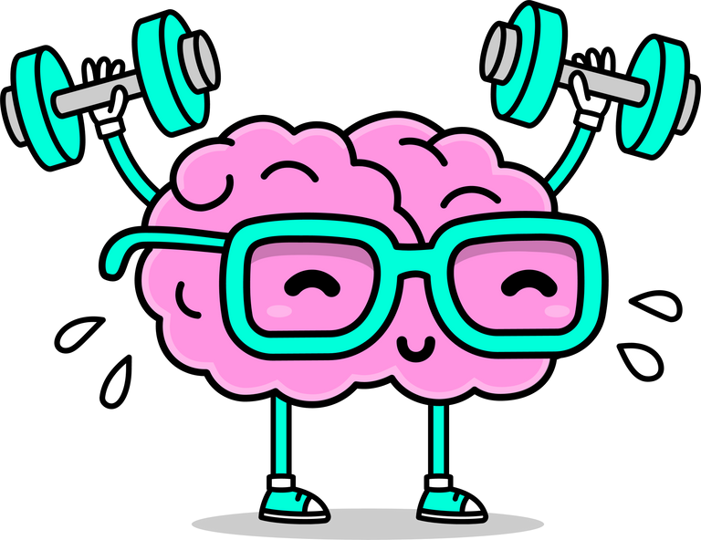

Mental and physical alertness are the primary reasons for consuming Energy drinks.

Slide 11
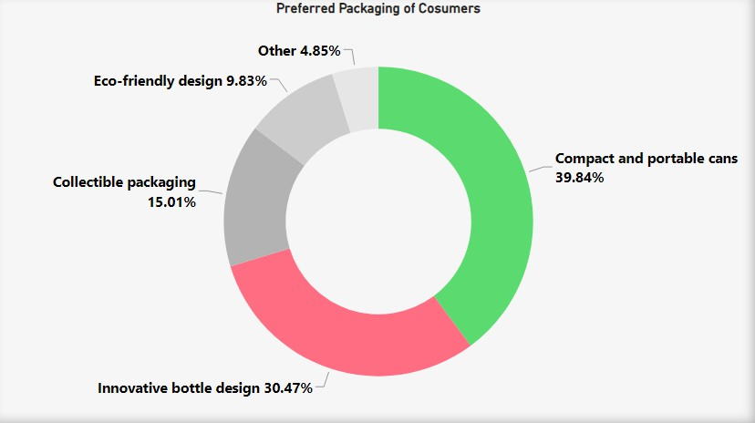

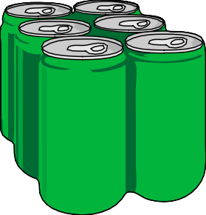
Approximately 40% of consumers prefer compact and portable cans, while 31% express a preference for innovative bottle designs.

Slide 12

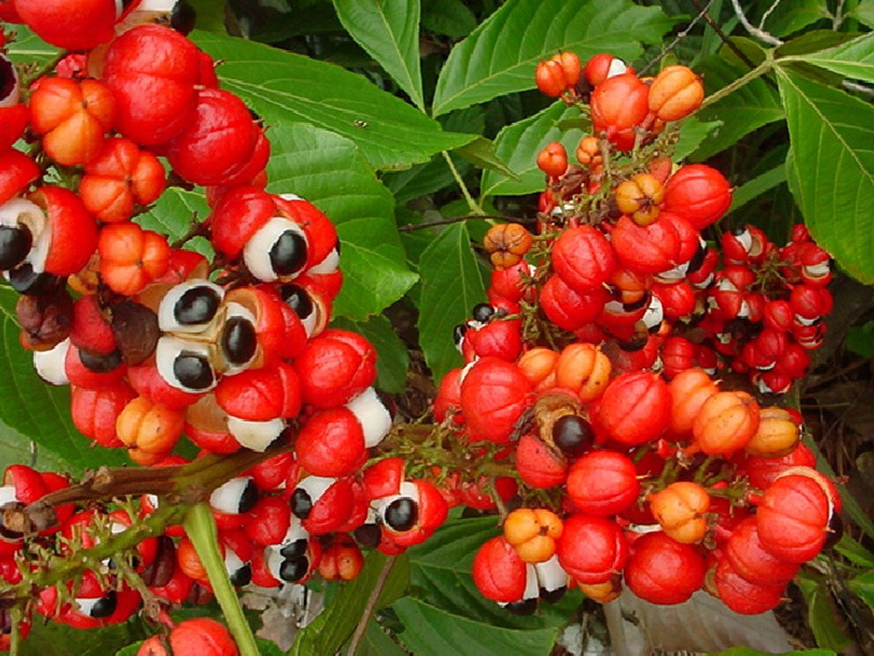
Suggestion for Ingredients
Green Tea Extract: Rich in antioxidants and moderate caffeine, it offers a natural energy boost without Discomfort.
Guarana: Natural caffeine source for sustained energy and mental alertness.

Slide 13



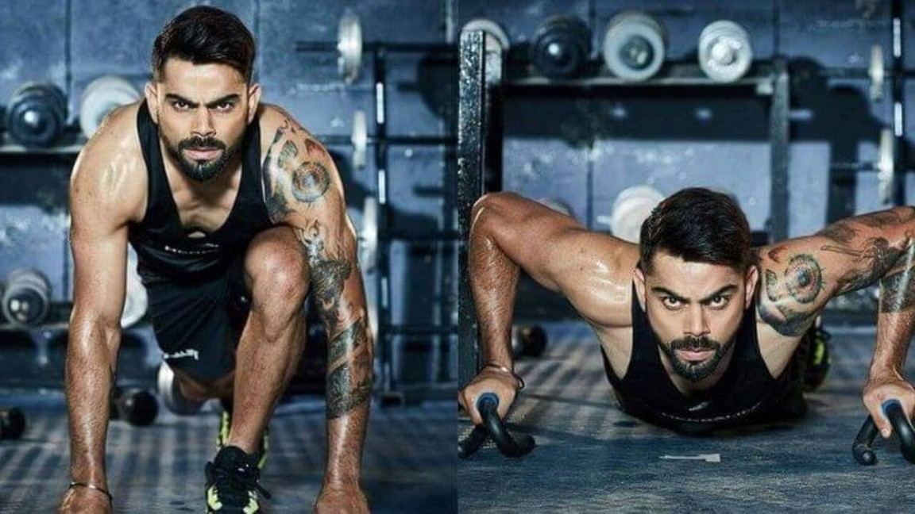

Suggestion for Brand Ambasdor
Virat Kohli is widely recognized for his exceptional mental and physical strength, which sets him apart as a remarkable role model for the youth.
With 253+ million Instagram followers, Virat Kohli has immense influence over the youth, making him an ideal ambassador for our product.

Slide 14
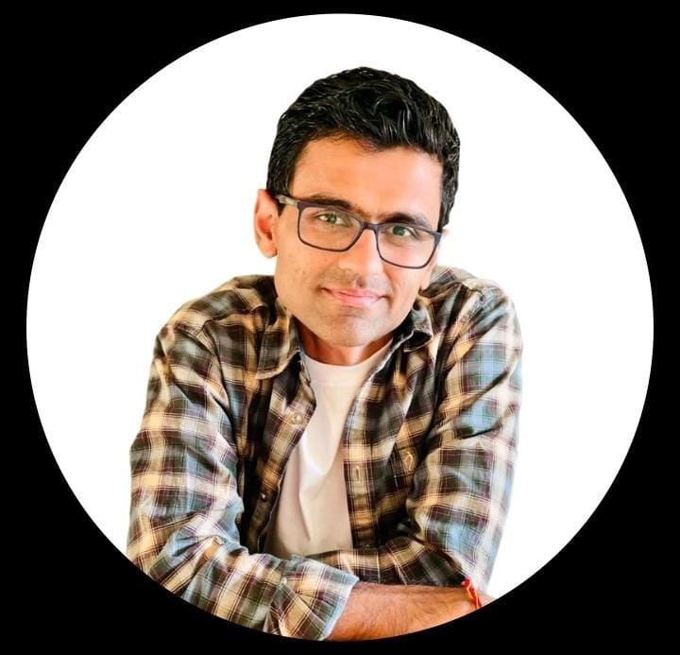

ThankYou
Dhaval Patel
Hemanand Vadivel

